Slide 1
TANZANIA TOURIST REPORT
Tourist spending behavior prediction

Slide 2
PROJECT OBJECTIVE
This project is aimed at building a machine learning model that will predict tourist spending behavior to help tourism operators estimate tourists expenditure.

Slide 3
DATA OVERVIEW
The prediction factors are:
Tourist age group.
Number of persons traveled with.
Purpose of travel.
Main activity.
Information source.
Tour arrangement mode.
Accommodation.
Food.
Transport.
Insurance packages.
Numbers of nights spent.
Payment mode.
Sightseeing.
Tour guide.
First trip .
Most impressing features.

Slide 4
UNI-VARIATE ANALYSIS
UNI-VARIATE ANALYSIS OF SOME IMPORTANT FEATURES

Slide 5
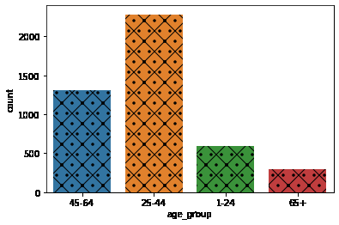
AGE GROUP FEATURE
The uni-variate analysis of the AGE GROUP feature shows the highest age group amongst the tourists are people between the age group 25-44 years while the least visiting age group are people 65 years and above. This shows less elderly tourist visit Tanzania.

Slide 6
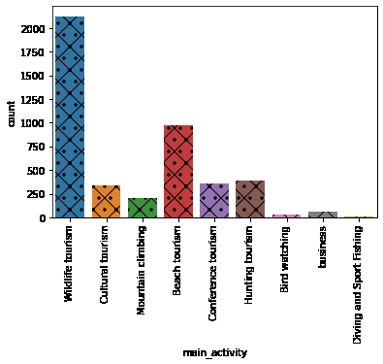
MAIN ACTIVITY FEATURE
This exploration shows the most explored activity is wildlife tourism, followed by beach tourism. The least explored activities are driving and sport fishing and bird watching.

Slide 7
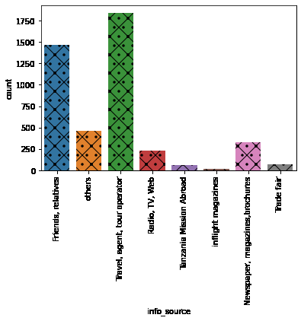
INFORMATION SOURCE
The highest information source for tourists is travel agent, tour operator, followed by friends and relatives . The least information source is in-flight magazine followed by Tanzania mission abroad.

Slide 8
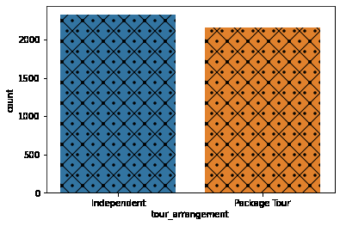
TOUR ARRANGEMENT
More tourists arrange for their visit independently than using a packaged tour. However, the difference from visualization is not much.

Slide 9
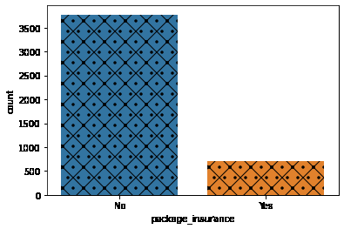
PACKAGE INSURANCE
Few tourist use package insurance, effort should be made to improve the package insurance deal to make it more attractive to tourists.

Slide 10
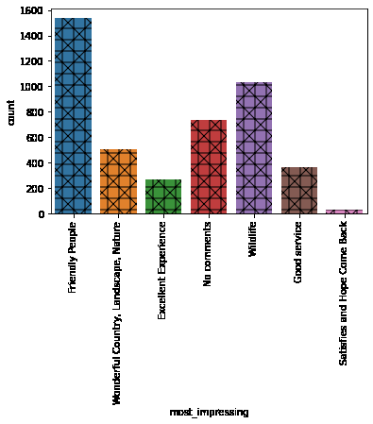
MOST IMPRESSING
The most impressing feature for tourist is friendly people followed by wildlife, only few tourist hope to come back, attention should be giving to other factors like good service so more tourist can hope to come back.

Slide 11
BI-VARIATE ANALYSIS

Slide 12
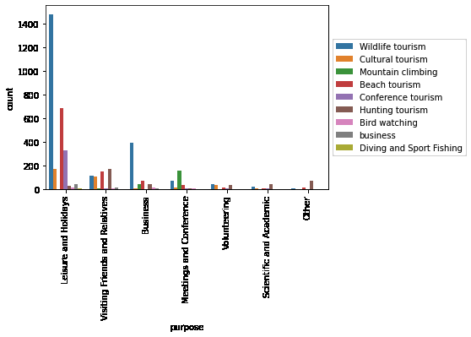
PURPOSE VS MAIN ACTIVITY
People who came in for holidays and business enjoyed wildlife tourism and beach tourism the most, all group of tourist have potential of exploring the tourism sights. More promo and discounts is recommend for volunteering and academic visitors to encourage their patronage.

Slide 13
MULTIVARIATE ANALYSIS

Slide 14
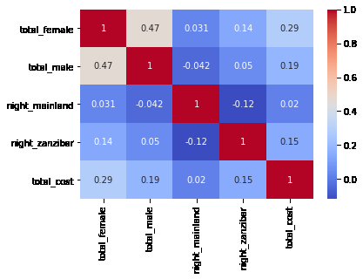
CORRELATION OF ALL NUMERICAL FEATURES
This heat-map shows a stronger correlation between total female and cost than total male and cost, this implies group with more females are prone to spend the more. The correlation co-efficient between total female and the nights spent is higher than the total nights spent by males. A negative correlation between total male and night mainland shows that men are less likely to spend the night on the mainland.

Slide 15
OBJECTIVE QUESTIONS

Slide 16
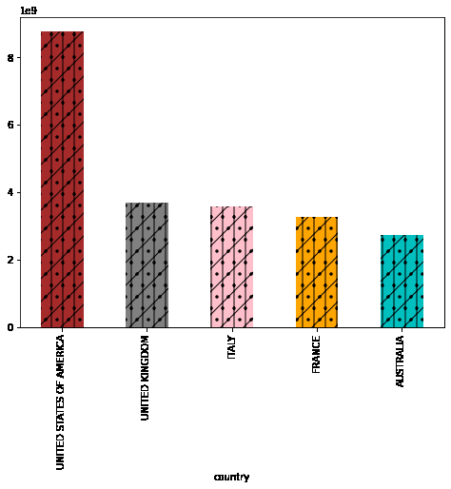
TOP 5 COUNTRY WITH HIGHEST SPENDING STATISTICS
Tourist from USA spent the most money. Tourist from these top 5 highest spending countries should be wooed in the most, using various marketing media, as they are the big spenders and areas of interest to these tourists should be giving more attention in order keep attracting them.

Slide 17
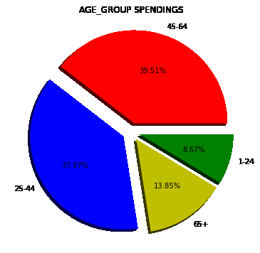
HIGHEST SPENDING AGE GROUP
Age 45-64 are the highest spending age group, tourist sight that are most impressing to these age group should be improved more. Promo and discounts are recommended for age group 1-24, the most appealing sights to the elderly should also be harnessed.

Slide 18
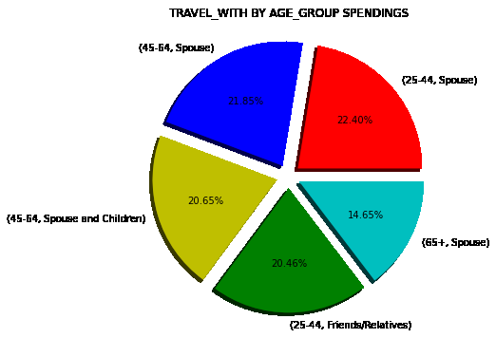
TOP SPENDERS BY TRAVEL WITH
Tourist between the age of 25-44 who travel with their spouse spends the most, these age range are young couples, so more lovers and honey moon packages are encouraged.

Slide 19
AVERAGE NIGHTS SPENT BY TOURISTS
Tourists spend more night’s on the mainland than in Zanzibar, the disparity is much. A further survey should be done to access the factors influencing the stay of tourist on the mainland, in order to incorporate the ideas into Zanzibar accommodation.
TANZANIA MAINLAND | 8.5199
ZANZIBAR | 2.3692

Slide 20
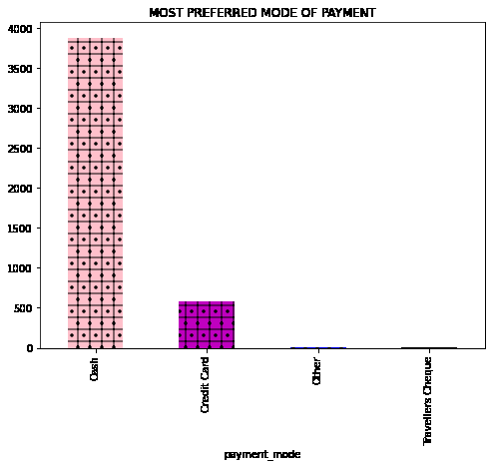
MOST PREFERRED PAYMENT MODE
The most preferred payment mode by tourists is cash. Hence, the need to work more closely with more bureau the change businesses, to enable easy of changing money for the tourists which contributes to their spending habits. Crypto-currency and cashless payment is recommended to be infused as a payment mode to encourage young tourist to spend more.

Slide 21
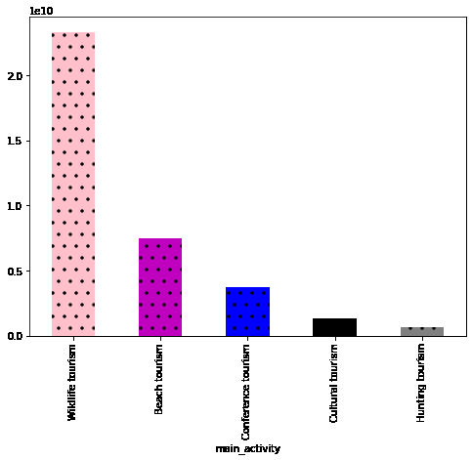
ASPECTS OF TOURISM WORTH INVESTING ON
The aspect of tourism worth investing in ,is wildlife tourism as it has more patronage from tourists. Profits is sure on investment. Hunting tourism is recommended for rejuvenation, more innovations are needed to make it more attractive to tourist. Beach tourism is also a good place to invest.

Slide 22
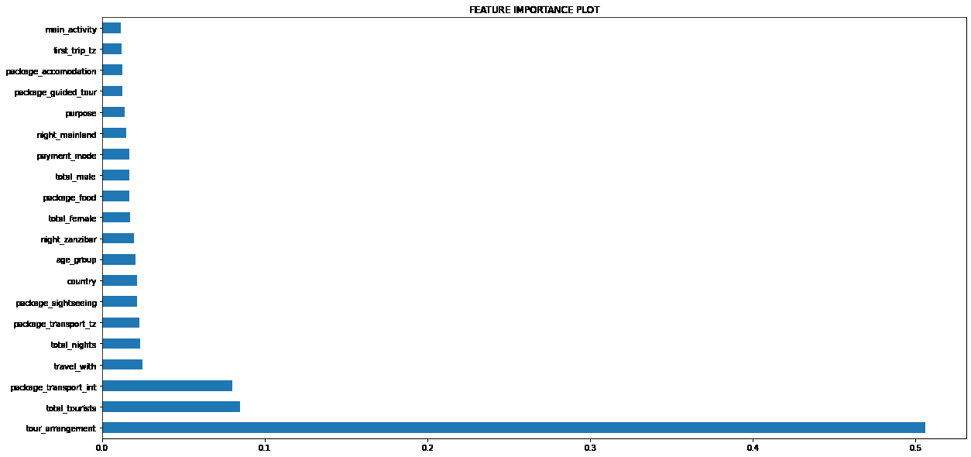
FEATURE IMPORTANCE
The feature importance gives us a general overview of the most important features that are vital in predicting the total cost. These features include travel with, package transport international, total tourists, and tour arrangement.

Slide 23
MODEL OVERVIEW AND PERFORMANCE
Linear regression model was employed for the prediction of the total cost. The model gave a coefficient of determination score of 0.25 which is low, so we explored other regression models like the XGBoost.
Model performance of the XGBoost is 0.20 which is lower, this might be as a result of the weak correlation between features. Hence, we suggest other regression models should be explored.

Slide 24
RECOMMENDATIONS
Further survey should be carried out on factors influencing the low rate of tourist spending the night in Zanzibar.
Attention should be given more to advertising on media, exploring social media advertisement is recommended as the world has gone digital.

Slide 25
RECOMMENDATIONS
More attention should be given to the number of persons a tourist travel with, package transport international, total tourists and tour arrangement as this a the for cardinal features that can predict a tourist expenditure.
These factors can also serve as a guide for travel agencies to estimate a tourists possible expenditure in order to prepare them before arrival.

Slide 26
THANK YOU

